Slide 1

Rainfall Prediction
Utilizing Random Forest Algorithm for Accurate Forecasting

Slide 2
Introduction
This presentation discusses the implementation of a Rainfall Prediction model using the Random Forest algorithm, achieving a model accuracy of 86.5%.

Slide 3

01
Project Overview

Slide 4
Objective and Goals
The primary objective of this project is to develop a machine learning model that accurately predicts rainfall. The goals include achieving high accuracy, minimizing errors, and effectively utilizing available meteorological data.

Slide 5
Machine Learning Approach
This project employs the Random Forest algorithm, a popular method for classification and regression tasks. It aggregates predictions from multiple decision trees to improve accuracy and control overfitting.

Slide 6

Random Forest Algorithm
The Random Forest algorithm is an ensemble learning method that builds multiple decision trees and merges them to get a more accurate and stable prediction. It works by randomly selecting subsets of data and features to train different trees, enhancing model performance while reducing the risk of overfitting.

Slide 7

02
Results and Evaluation

Slide 8
Model Accuracy
The implemented Random Forest model achieved an impressive accuracy of 86.5%, demonstrating its effectiveness in predicting rainfall. This level of accuracy ensures reliable forecasts, which are crucial for various applications such as agriculture, disaster management, and resource planning.

Slide 9
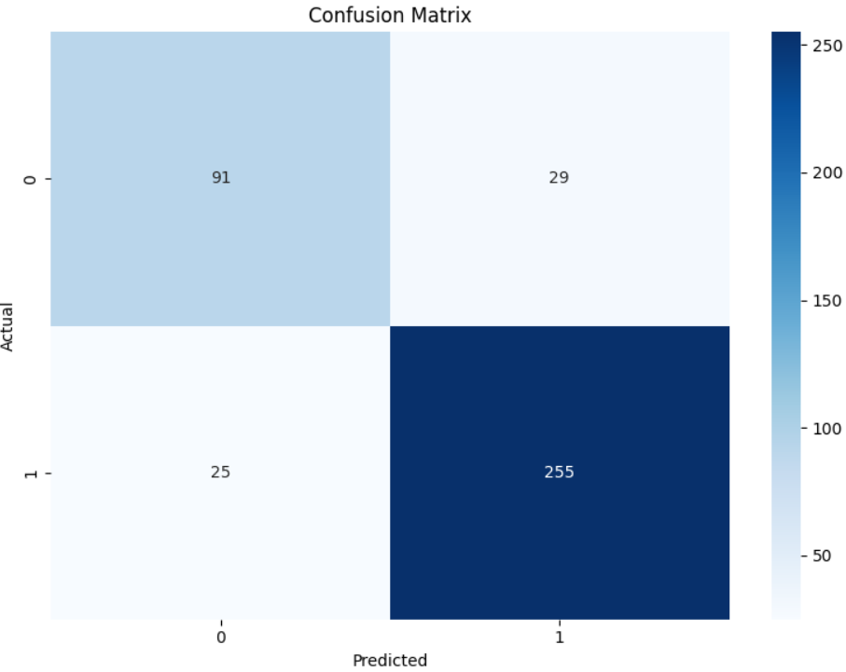
Performance Metrics
In evaluating the model, metrics such as precision, recall, F1-score, and the confusion matrix were utilized. These metrics provided insights into the model's strengths and weaknesses, allowing for further refinements and validation of its predictive capabilities.

Slide 10
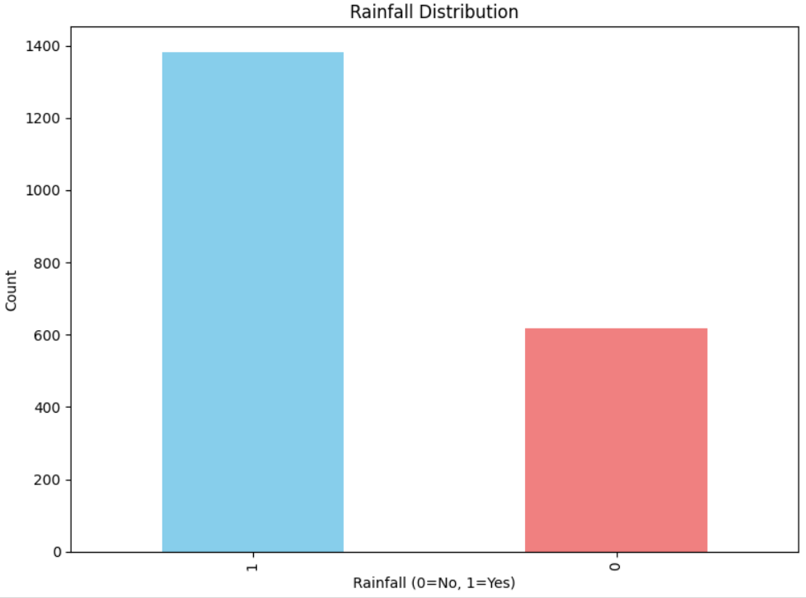
Output Generation
The final output of the model consists of predicted rainfall probabilities, which can be visualized through graphs and charts. This output facilitates easier interpretation and planning for stakeholders, ensuring actionable insights based on predictive analytics.

Slide 11
Conclusions
This presentation highlighted the successful implementation of a Rainfall Prediction model using the Random Forest algorithm, achieving 86.5% accuracy. The findings reinforce the algorithm's suitability for complex forecasting tasks, providing a valuable tool for decision-makers in various sectors.

Slide 12
Thank you!
SIVATHANU K P(220701280)
SASIKUMAR S(220701525)
VENKATA HEMA KUMAR A(220701315)
Do you have any questions?
Please keep this slide for attribution

